Slide 1
ABA Tool
Guide to setting up and reviewing Self Assessments
http://uat.rcpsych.weblogik.co.uk/

Slide 2
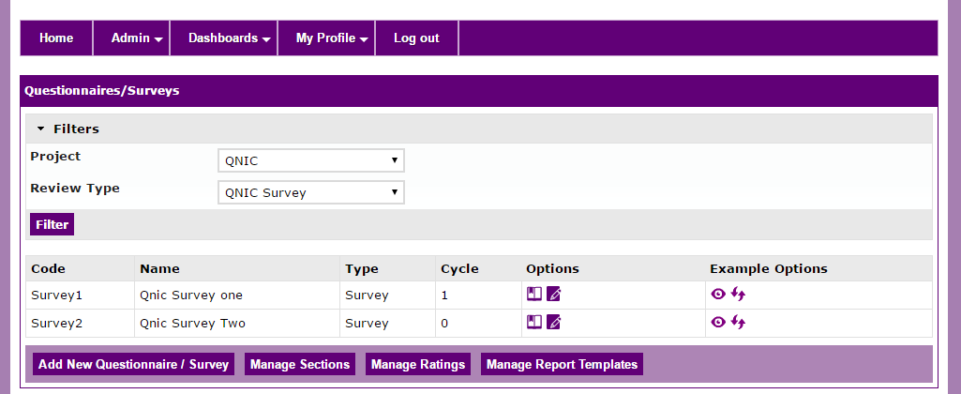
Manage Self Assessments
To create a self assessment, Log in as an admin/Project admin
(currently project worker is not allowed to access this page)
Then navigate to ‘Manage Questionnaires’
Once on this page, ensure you have selected the relevant project and review type i.e. ABA ACMH / ABA ACMH Self Assessment

Slide 3
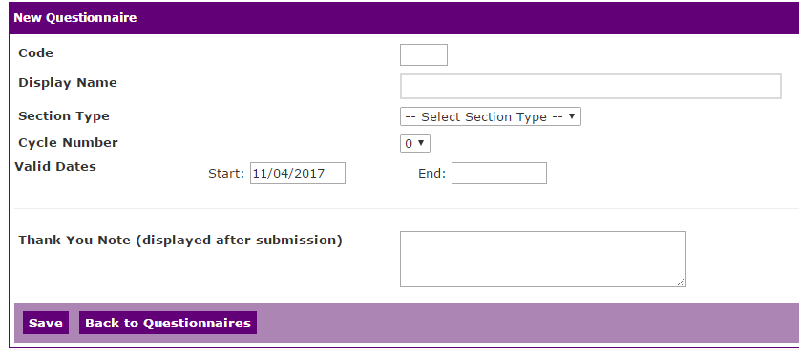
Creating a new Self Assessment
After ensuring you have the correct Project and review type selected click ‘Add New Questionnaire’
The next screen is fairly self explanatory, Once all the fields are filled (end date is NOT mandatory) click ‘Save’

Slide 4
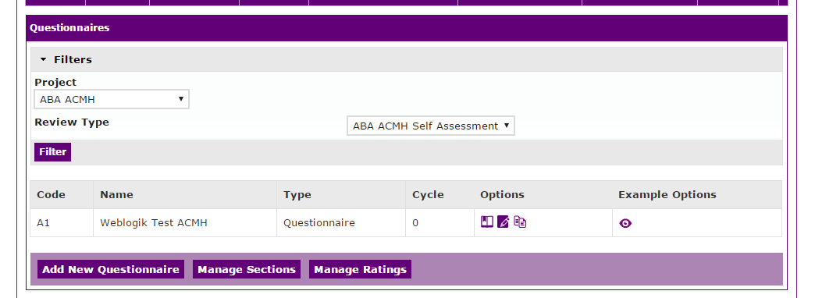
You should now see your new questionnaire in the list
View/Edit sections
Edit
Copy
View Example
Your next step will be to add sections, so Click the ‘Manage Sections’ button at the bottom of the page

Slide 5
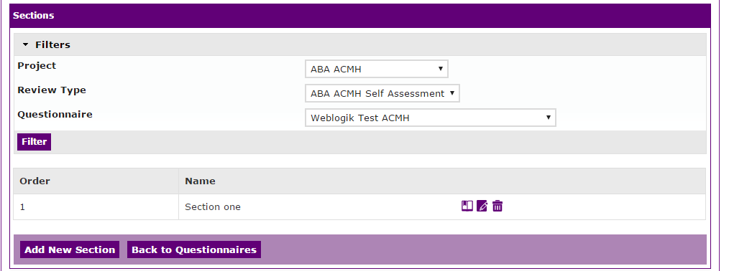
View Questions
Edit
Delete
Ensure the correct values are selected in the dropdowns, then click ‘Add New Section’, once there you can give your section a title. As you can see from the screenshot I have created one called “Section one”
Next step is to add some questions, once you have created at least one Section, click the ‘View Questions’ icon

Slide 6
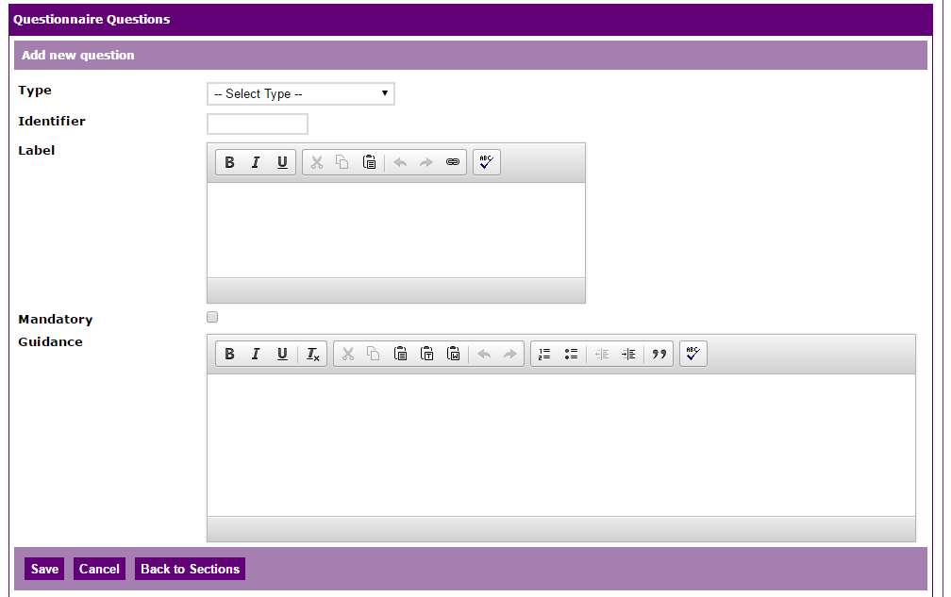
Adding Questions
The following page is fairly self explanatory, You have the option of multiple question type, each having their own sub options

Slide 7
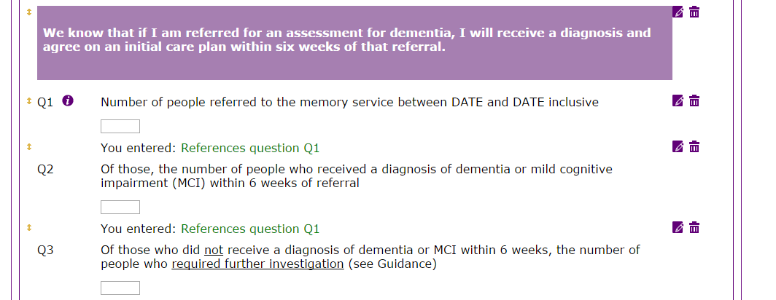
Once you have created a question click ‘Save’ and then you will be able to scroll down and see how the final questionnaire will look
On this page you can ‘drag and drop’ the questions to amend the ordering. There are also a few icons for editing, deleting and a ‘Info’ icon which lets you know at a glance which questions are related

Slide 8
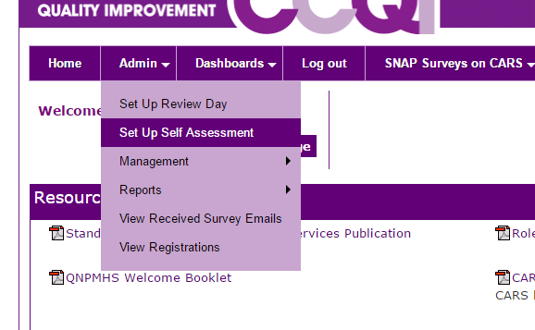
Creating a Self Assessment
To create a new Self Assessment, go to Admin > Set Up Self Assessment

Slide 9
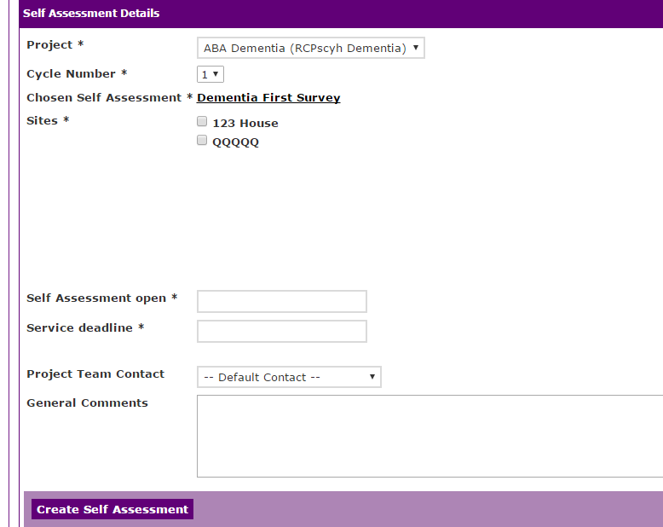
Once here, select the relevant Project, Cycle and select the Services you wish to participate. Along with the relevant dates and contacts. Once happy click ‘Create Self Assessment’

Slide 10
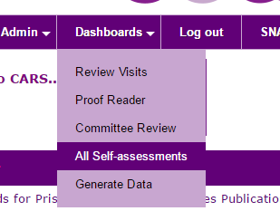
Viewing Existing Self Assessments
To view existing self assessments, go to Dashboards > All Self Assessments (Site users will have an option here to go directly to their services active assessment)

Slide 11
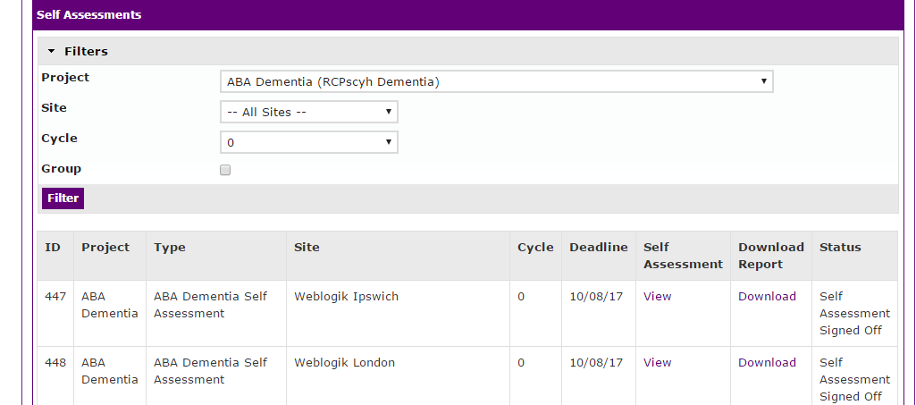
This page will show you a list of all assessments for the selected projects
To view to assessment click ‘View’
To edit and publish the report click the row

Slide 12
You can edit the self assessment by clicking the row (as previously mentioned)
On this page you can amend dates (clicking ‘Edit individual’ if you have multiple services for one self assessment)
Once the assessments have been completed and signed off by a Site user you should a new button ‘Publish Final Workbook’ click this button and on the list page you will see a ‘Download’ link
Clicking this will generate a report with the results for your self assessment.

